Slide 1
Eclipse Plug-in Development
Introduction of GEF and EMF

Slide 2
Contents
EMF – Eclipse Modeling Framework
EMF Model
EMT Edit
EMT Editor
GEF – Graphical Editing Framework
EditPartViewer
EditParts (Model, Controller and Figures)
Editing and EditPolicies
Tools and Palette

Slide 3
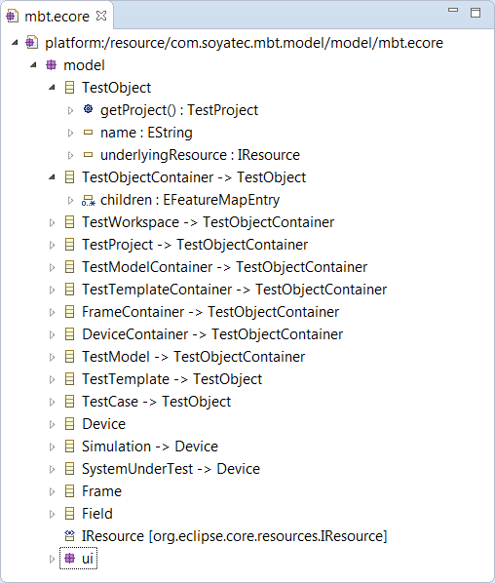
EMF
Define ecore model
EClass
EAttribute
EReference
EOperation
EDataType
EEnum
EEnumLiteral
EPackage
EAnnotation

Slide 4
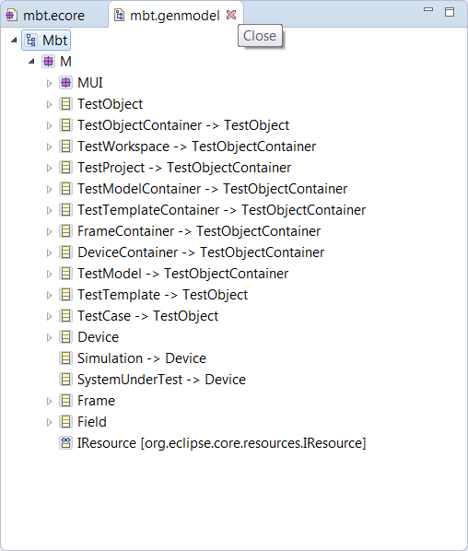
EMF
Generating an EMF Model
Base package
Settings
Model
Edit
Editor
Test

Slide 5

EMF
Generated codes
model project
Primary models
model.edit project
ItemProviders, label, image, content
model.editor project
Multi page editor
model.test project
Testcases

Slide 6
EMF
Using the generated EMF classes
LibraryFactory factory = LibraryFactory.eINSTANCE; Book book = factory.createBook();
Writer writer = factory.createWriter(); writer.setName("William Shakespeare");
book.setTitle("King Lear");
book.setAuthor(writer);

Slide 7
EMF
Example in Eclipse

Slide 8
GEF
Overview
Display of any model graphically using draw2d figures
Support interactions from mouse, keyboard, or the Workbench
Provide common components related to the above

Slide 9
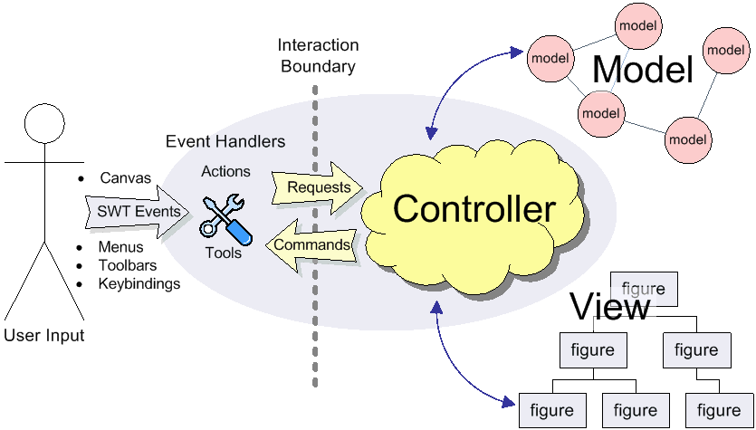
GEF
GEF MVC design
Model
View (Figures/TreeItems)
Controller (EditPart)
Viewers
EditPartViewer

Slide 10
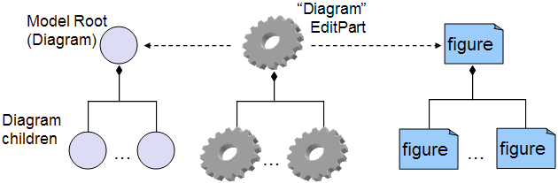
GEF
EditPart
Create and maintain a view (whether figure or treeitem)
Create and maintain children editparts
Create and maintain connections editparts
Support editing of the model

Slide 11
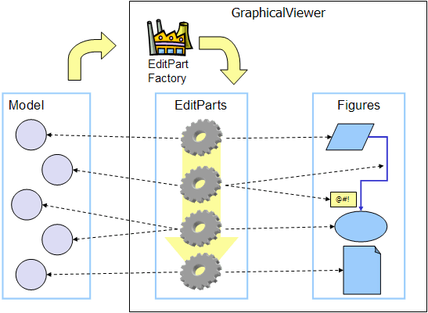
GEF
Viewer - EditPartViewer
GraphicalViewer
ScrollingGraphicalViewer
ScalableRootEditPart
ScalableFreeformRootEditPart - additionally extend into negative coordinates (to the left and up).
TreeViewer
SWT Tree

Slide 12
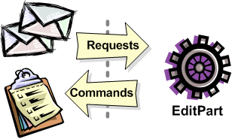
GEF
Editing and EditPolicies
EditPart getTargetEditPart(Request)
boolean understandsRequest(Request)
void showSourceFeedback(Request)
void eraseSourceFeedback(Request)
void showTargetFeedback(Request)
void eraseTargetFeedback(Request)
Command getCommand(Request)
void performRequest(Request

Slide 13
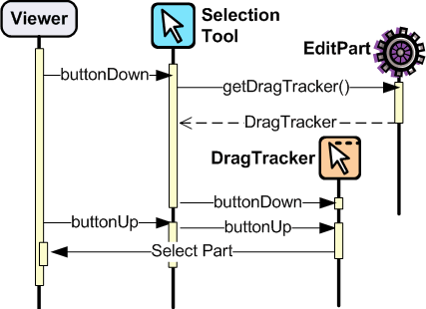
GEF
Tools and the Palette
Asking editparts to show or hide feedback.
Obtaining commands from editparts.
Executing a command on the command stack.
Updating the mouse cursor.

Slide 14
GEF
Types of Interactions in GEF
Invoking some Action (usually displayed on the toolbar, menubar, or popup).
Clicking on something.
Clicking and dragging something.
Hovering over something (pausing the mouse for a certain time).
Dropping something dragged from another source (native Drag-N-Drop).
Pressing certain keys.

Slide 15
GEF
Example in Eclipse

Slide 16
Any Questions?
Skype: jin.liu.soyatec
Email: jin.liu@soyatec.com

Slide 17
The end

